Slide 1
William Shakespeare

Slide 2
Hook
Robin Williams on Johnny Carson: https://www.youtube.com/watch?v=oU73kj5Sw9M.

Slide 3
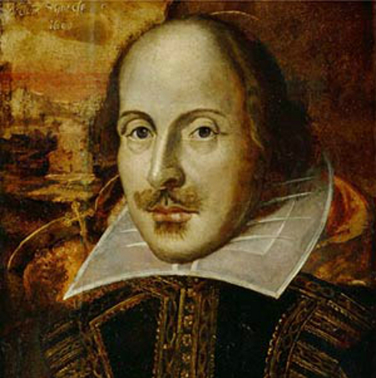
Pictures of Shakespeare
← Young
Old →

Slide 4
Renaissance Period/Drama
The reign of Queen Elizabeth (1558-1603) is known as the Elizabethan age in England—a period of discovery and prosperity as well as a period of great achievement in the arts, especially drama.

Slide 5
Queen Elizabeth I
The Virgin Queen (?) A Protestant Queen.
Both houses in Parliament placed a lot of pressure on Elizabeth to bear an heir.
The fifth and last monarch of the Tudor Dynasty.
Daughter of Henry VIII by second wife, Anne Boleyn.
King Henry VIII and the Protestant Religion.
After Henry’s death, his son Edward VI ruled until his death in 1553. Then, after the nine day rule of Lady Jane Grey, Mary took over.
During Mary’s rule, Elizabeth was imprisoned for nearly a year on suspicion of supporting Protestant rebels.

Slide 6
Queen Elizabeth I
Mary I of England, or “Bloody Mary” was a devout Roman Catholic. Mary wanted to bring back the Catholic ways and eliminate the Protestant religion. Her name “Bloody Mary” comes from her many executions of Protestants.
When Mary died on November 17, 1558, Elizabeth became queen.
One of Elizabeth’s first actions as Queen was the establishment of an English Protestant church, of which she became the Supreme Governor.
In government, Elizabeth was more moderate than her father and half-siblings had been. One of her mottoes was "video et taceo" ("I see, and say nothing"). In religion she was relatively tolerant and avoided systematic persecution.

Slide 7
Elizabeth I
Elizabeth's reign is known as the Elizabethan era. The period is famous for the flourishing of English drama, led by playwrights such as William Shakespeare and Christopher Marlowe, and for the seafaring prowess of English adventurers such as Francis Drake. Some historians depict Elizabeth as a short-tempered, sometimes indecisive ruler, who enjoyed more than her share of luck. Towards the end of her reign, a series of economic and military problems weakened her popularity.

Slide 8
Queen Elizabeth I and James VI of Scotland
In the late spring or early summer of 1585, Elizabeth began a correspondence with James VI of Scotland. Elizabeth was fifty-one years old; James celebrated his nineteenth birthday in June. Previously the two sovereigns had communicated through their respective ambassadors and the messages orally entrusted to them. Then, in mid-1585, Elizabeth and James begin to write directly to each other. The correspondence continues at irregular but not infrequent intervals until Elizabeth's last letter of January 6, 1603, slightly more than two months before her death

Slide 9
Elizabeth I and James VI
The end of all marriage prospects for Elizabeth--her last courtship, to French prince Francois Hercule de Valois, had ended definitively the previous year--had the political and structural effect of relieving her from having to contract a single, exclusive foreign alliance with a consort-to-be and his blood relations. But the end of all marriage prospects also had the political and structural effect of rendering the question of Elizabeth's successor more urgent.

Slide 10
James VI of Scotland I of England
Famous for creating the King James Bible in 1611. He never actually created the bible; he just authorized for its creation.
Considered one of the most intelligent, yet controversial Kings to rule of England.
In accordance to the religious atmosphere of the time, he was brought up as a Scottish Presbyterian, though his mother had been a Roman Catholic (which caused controversy with the English people).
Married to Ann of Denmark and had a total of eight kids, of whom only three lived beyond infancy.
Considered bisexual, as he had close relationships with a number of men, and it was widely known by many people.

Slide 11
Why is this history important to our study of Shakespeare?
Shakespeare lived and wrote in the time during Elizabeth’s later years and James’s earlier years. He saw and witnessed it all, and it is clear that this history is huge part of the subtext of his plays.
For instance, Catholicism and Protestantism had a huge influence on his plays. Shakespeare had to censor his plays around the Catholic and Protestant rules.
Hamlet was written around the time of the change from Elizabeth to James, and this succession is a subtext of Hamlet.
And James’s sexuality is a subtext of many of Shakespeare’s plays.

Slide 12
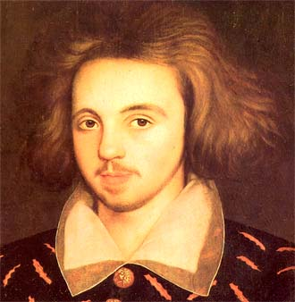
Other Great Dramatists
Johnson →
Marlowe →
The great playwrights of the era were: Thomas Kyd, Christopher Marlowe, William Shakespeare, Ben Johnson, John Marston, John Fletcher, John Webster, Thomas Middleton, and John Ford.

Slide 13
Plays before the Theatres
Many of the popular plays before the theaters were build were in a square inn yard, with a balcony above.
The shape was often octagonal or circular, like the bear pits in which bears, tied to stakes, were baited by dogs for the amusement of the audience. The stage was raised about five feet from the ground with levels of seating in several galleries. Approximately half the area over the stage was roofed and contained machinery to lower actors from the “heavens”; it was painted blue with stars to simulate the sky. Doors or curtained openings at the back of the stage served for entrances and exits, and at the back of the stage was a special room for costume changes.

Slide 14
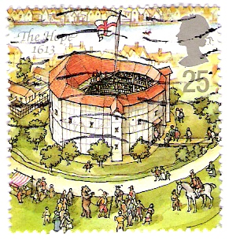
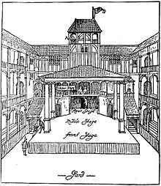
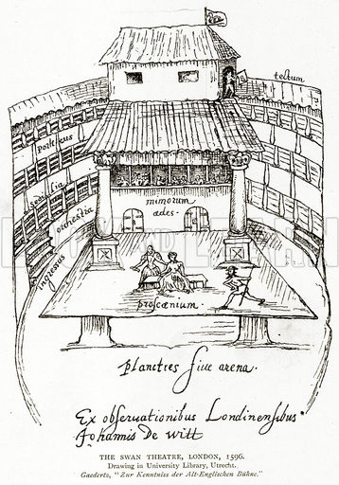
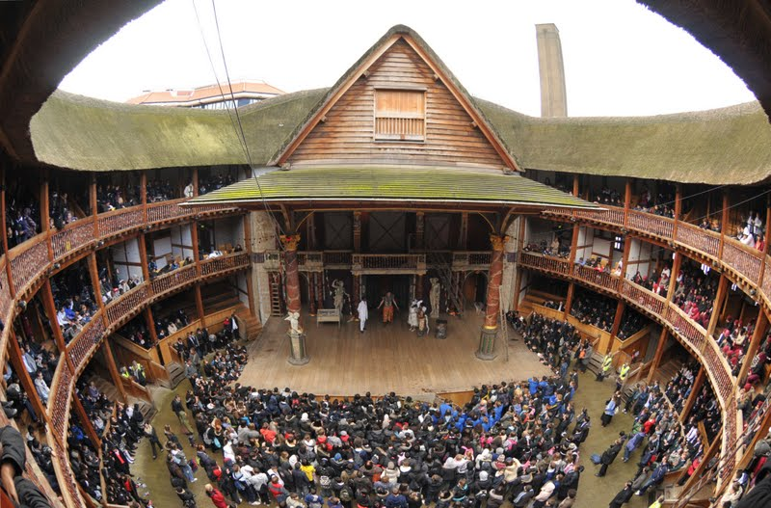
The Theatres
← The Hope
The Rose →
The Fortune →
← The Globe
The Swan →

Slide 15
The Globe Theatre
Shakespeare’s Globe theatre was built in 1598. An expired lease forced them to move from their previous theatre across the River Thames to a more permanent spot.
It was the basis of a three year-long lawsuit. The building was constructed in a circular fashion.
The Globe was large enough to accommodate two to three thousand people. Because these theaters were open-air, they could not be used in winter.

Slide 16
While Shakespeare’s plays were performed at a variety of theatres, none were more famously known than the ones that were performed at the Globe Theatre. The Globe had its origins with a man named James Burbage. Building the Globe was no easy task; it was a hundred feet wide, it was constructed in a circle with twenty sides that could roughly hold three thousand audience members. The center area held a huge chunk of the audience.
Once the Globe Theatre was built in 1599, their company, The Chamberlain’s men, included some of the most acclaimed actors of the day.

Slide 17
The entrance fee to the theaters was a penny, probably the equivalence of five to ten dollars in today’s money. For another penny, one could take a seat, probably on a bench, in one of the upper galleries.
Plays were performed during the day because they had no way of lighting it at night.
It was festive, crowded, and noisy. The actors really had to compete with the rest of the audience for airtime, and for the attention of the audience. And another signal difference, for an additional sum, you could actually sit on the stage and watch the performance.
On June 29, 1613, the original Globe Theatre burned down. Supposedly due to a cannon shot during the performance of Henry VIII. The company reconstructed the theatre without Shakespeare and continued to operate until the Puritans shut them down in 1642. The remains were discovered in 1989 and excitement quickly grew to build the reconstruction of the Globe. This project was completed in 1996 and was christened by Queen Elizabeth II with a production of Henry the V. It continues to operate today often pulling in crowds from all around the world.

Slide 18
The Actors
In the early 16th C., professional companies roamed the countryside with, usually, four actors and a boy who could play the female roles. Musicians may have accompanied the actors.
Actors were still regarded as somewhat disreputable, and stories were told of actors disguised as royalty stopping in a tavern for a drink and fooling the populace, who grew surly at such tricks.
The actors spoke in a high-style formal dialogue.
Women were not allowed to act on English stages because the theater was considered morally questionable. Boys and young men played the parts of young female characters. Older women were played by some of the gifted male character actors of the company.

Slide 19
The Playgoers
Many of the Elizabethan actors played to the audience as much as they related to each other, a trait that seems to have developed in response to the structure of the stage, with an audience on three sides and with some notables actually sitting on the stage itself.
Playgoers around the stage were nicknamed “groundlings.” Hamlet calls them the “understanding gentlemen of the ground.” Both Marlowe and Jonson used the term to mean those who would not perfectly understand the significance of the plays.
Because of the comedies, the audiences were widely diverse.

Slide 20
William Shakespeare
Wrote 37 plays, owned part of his theatrical company, acted in plays, and retired a wealthy man in the city of his birth.
Born in April 1564 and died in April 1616.
Married Anne Hathaway in 1582, when he was eighteen and she was twenty-six. They had a daughter Susan and twins, Judith and Hamnet. Hamnet, his only son, died at age 11.
Shakespeare may have gone to grammar school. And if he did, he would have received a very strong education based on rhetoric, logic, and classical literature. In grammar school, he would have been exposed to the comedies of Plautus, the tragedies of Seneca, and the poetry of Virgil, Ovid, and a host of other, lesser writers.

Slide 21
William Shakespeare
Some claim that since he wasn’t highly educated—that of university level—and that another person, with considerable university education, must have written his plays. Since Shakespeare only ever signed his will, many people use that as evidence for the plays not being his. Lord Edward de Vere, the 17th Earl of Oxford, is whom some critics believed the plays belong to. Most scholars and critics do not believe this to be true, especially since those critics against Shakespeare also believe that de Vere had illegitimate children with Queen Elizabeth.
Shakespeare’s competition would have been Marlowe, who if he hadn’t died young, would have been just as, if not more popular than Shakespeare, according to many scholars.

Slide 22
William Shakespeare
Shakespeare’s early years suggest that he may have belonged to a wandering company of actors much like those who appear in Hamlet.
His company was called the Lord Chamberlain’s Men while Queen Elizabeth was alive, but was renamed the King’s men by King James in the spring of 1603, less than two months after Elizabeth died.
Shakespeare wrote histories, comedies, tragedies, and romances. However, his most notable work (that which he put most effort into) are his sonnets. He wrote a total of 154 sonnets that deal with time, love, beauty, and morality. The first 17 sonnets are addressed to a young man telling him to marry and have children; then he goes on to express his love for the young man (even though he can’t have him due to society); then he goes into loneliness, death, and life; and he finishes with his expressions towards his mistress (whom he doesn’t seem to be attracted to). Shakespeare’s sonnets are one of the reasons why contemporary critics questions Shakespeare’s sexuality, especially since the sonnets were not meant to be published.

Slide 23
Hamlet Background
Wrote in 1600-1601.
Shakespeare’s boldest, most profound play and is a landmark in the poet’s work.
It coincides with the new century and the uncertainties of the last years of the old regime, brought to an end by the death of Queen Elizabeth in 1603. Until the very moment of her death, the succession was in doubt, but at her death she indicated that her cousin James of Scotland would take the throne. The new age was in many ways more complicated, more ambiguous, and more democratic than the old. It was also more dangerous because it was more uncertain.

Slide 24
Hamlet Background
Hamlet is a revenge tragedy.
Characteristics of a revenge tragedy: the revenge of a relative’s murder or rape; the revenge of a father by a son, or vice versa; the appearance of a ghost; the hesitancy or delay of the hero; tricks or devices to achieve revenge; the use of real or pretended insanity; suicide; political intrigue in a court; an able, scheming villain who is a ruler above the law; philosophical soliloquies; and sensational use of horror (murder and gore onstage).

Slide 25
Hamlet Background
Setting: Denmark
What the audience knows before the play begins: Old King Hamlet has died (we don’t know why) and Queen Gertrude remarries Old Hamlet’s brother Claudius shortly after the funeral. We don’t necessarily know why, but Claudius has become king. Young Hamlet, who is around nineteen, has come from Wittenberg (university) to Denmark for his father’s funeral, but stays longer than expected (due to his mother’s marriage).
Also, before Old Hamlet died, he killed and defeated the King of Norway and took some land. Young Fortinbras (Norway’s son, who’s uncle is also King) wants revenge against Denmark for his father’s death.

Slide 26
Who is Hamlet?
The protagonist, Hamlet, is a scholar at the University of Wittenberg where he studies theology, and therefore is able to understand the world of the spirits. Perhaps he also studies medicine and law. He gives evidence of knowing literature and having a taste for theatre, and he is a ready hand with weapons when necessary.
Hamlet is melancholic: is introspective, thoughtful, perhaps world-weary, and possibly a touch sardonic.
Hamlet is an intellectual, a person with a wide-range of knowledge and intelligence.

Slide 27
Let’s Read!

